Slide 1
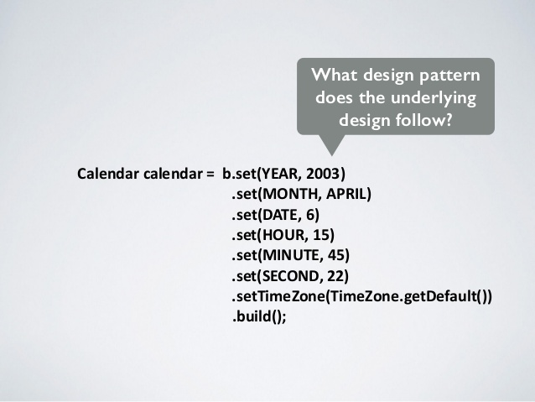
Builder Pattern
- Harshil Shah
- Nithin V
- Vinod Adwani
- Yashaswa Jain

Slide 2
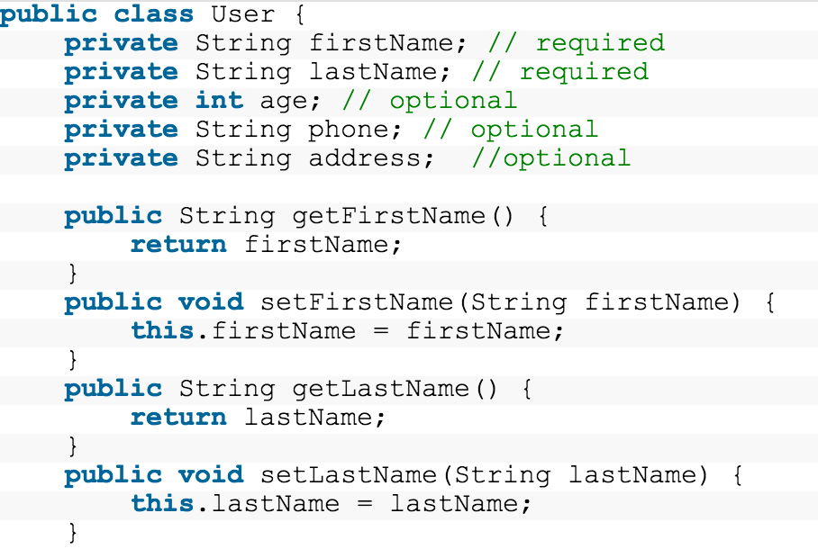
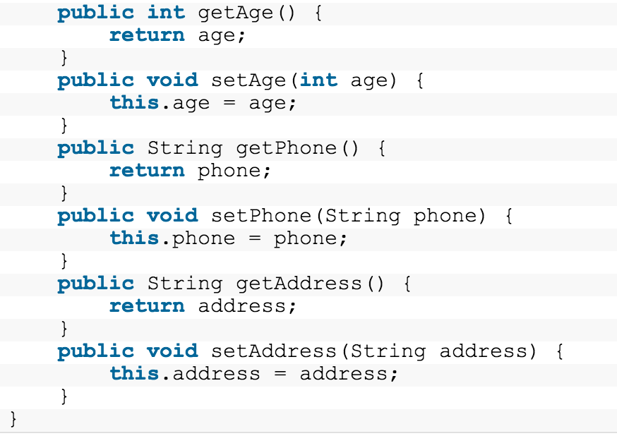
Creating a Class (Using setters, getters)

Slide 3
Problem with this Approach
Leads to inconsistent states.
Client can just create an empty object and then set only the attributes that he/she is interested in.
Object will not have a complete state until all the setX methods have been invoked.
This approach makes the User class mutable.

Slide 4
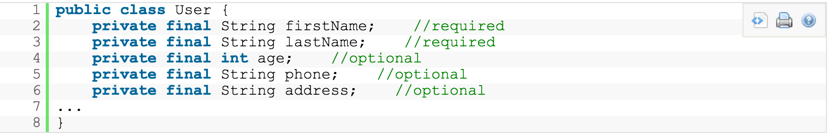
Immutable Classes are cool!
Always make immutable classes!
Unless there’s a really good reason not to do so.

Slide 5

Why immutable?
Immutable classes are faster (can be cached!) and safer.
Simplicity - each class is in one fixed state only.
Thread Safe - because the state cannot be changed, no synchronization is required.

Slide 6
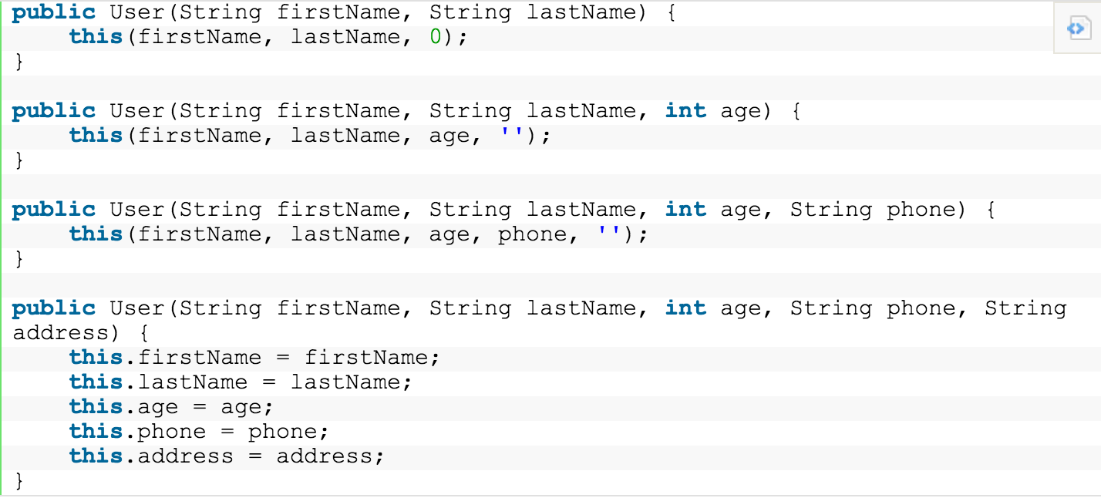

Second Approach ( and it works!)

Slide 7
Problems!
As number of attributes increases, the code becomes harder to read and maintain.
Constructors = 2^(number of attributes) :('

Slide 8


Slide 9
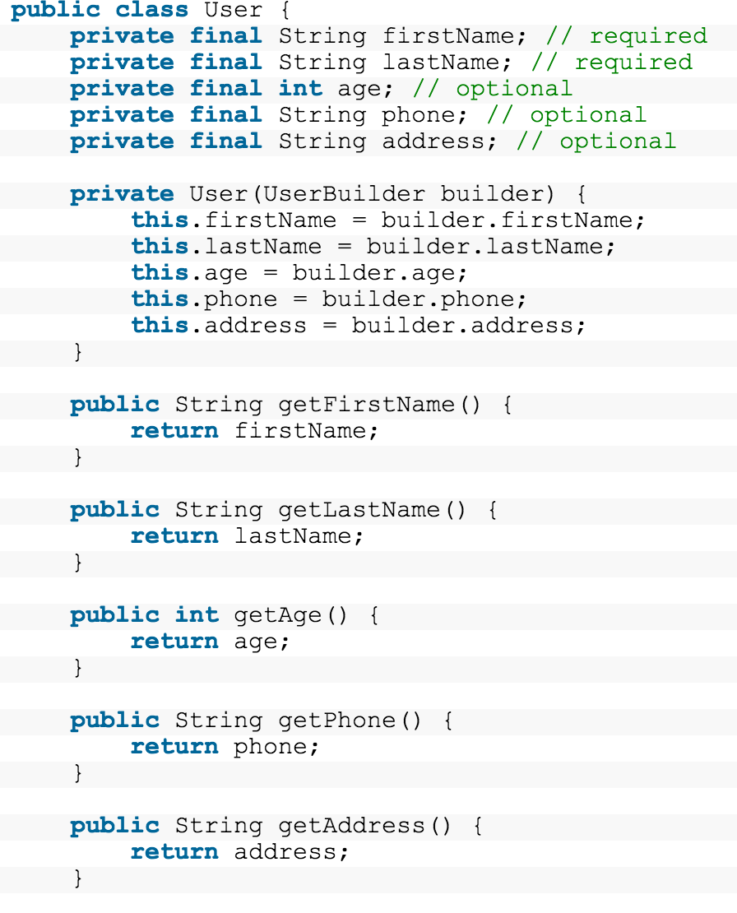
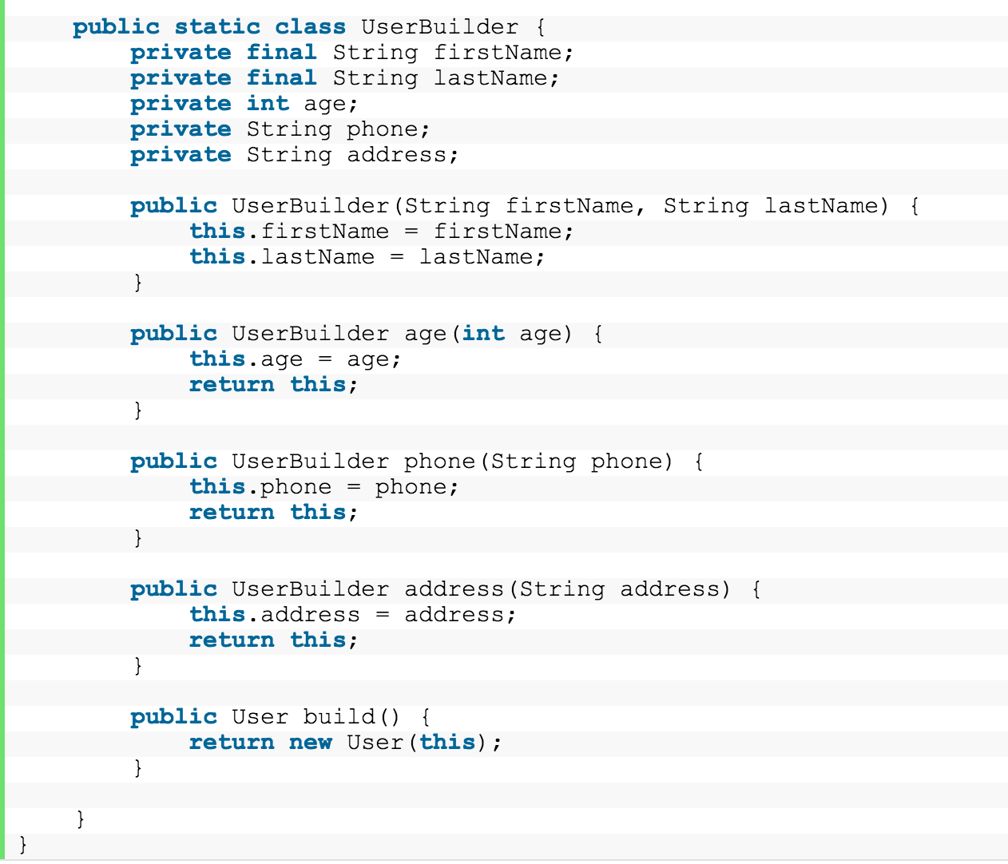
Builder Pattern

Slide 10
Points to note:
The User constructor is private
The class is immutable.
The builder constructor only receives the "required" attributes and all the required attributes need to be final in Builder class.

Slide 11
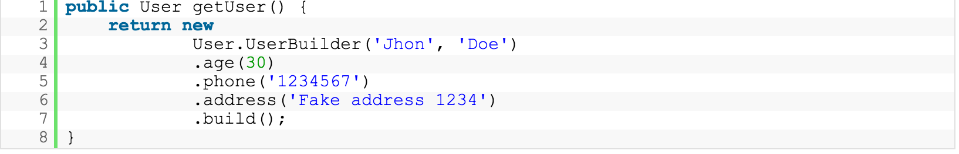
Object in one Line!

Slide 12
Advantages:
Build a object in 1 line of code.
Easier to read and write.
A single builder can be used to create multiple objects (Not possible in other languages).
A builder could be passed to a method to enable this method to create one or more objects. The method need not know any kind of details about how the objects are created.

Slide 13
Summary
Excellent choice for classes with lots of parameters ( especially parameters are optional )!
Easier to read, write and maintain.
Classes can remain immutable, makes your code safer.

Slide 14
Builder Pattern Dobaara
- HARSHIL SHAH
- NITHIN V
- VINOD ADWANI
- YASHASWA JAIN

Slide 15
Builder Pattern
Object creation software design pattern
The intention to find a solution when the increase of object constructor parameter combinations leads to an "exponential list of constructors".
It uses another object, a builder, that receives each initialization parameter step by step and then returns the constructed object at once.

Slide 16
Definition
The intent of the Builder design pattern is to separate the construction of a complex object from its representation.
By doing so the same construction process can create different representations

Slide 17
Components
Builder
An abstract interface for creating parts of a Product object.
Concrete Builder
Implements the builder interface.
Defines and keeps track of the representation it creates.
Director
Uses the Concrete Builder and constructs the object.
Product
The object that is being built.

Slide 18
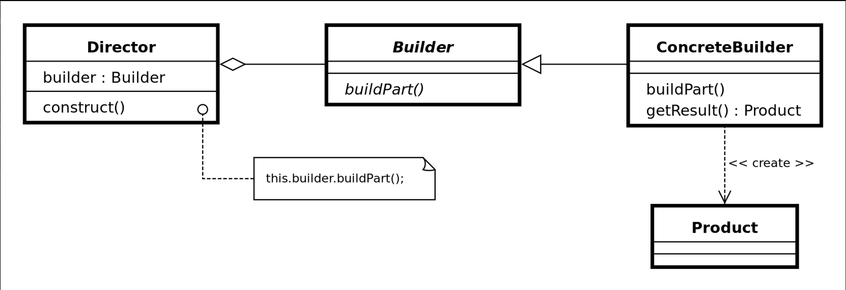
Structure

Slide 19
Advantages
Provides control over steps of construction process.
Encapsulates code for construction and representation.
Allows you to vary a product’s internal representation.

Slide 20
Disadvantages
Requires creating a separate ConcreteBuilder for each different type of Product (Not a disadvantage in Java!)
Requires the builder classes to be mutable.
Introduces a lot of code, bigger problem if builder pattern is misused.

